Slide 1

IOT Assignment 2 Raspberry Pi Based Network Monitoring System
Student Name: Sankha Subodha Palapotha Liyanage
Student ID: 1484052
Student Name: Jin Tae Kim
Student ID: 1485971
Student Name: Ovini Wasanthi Galbokka Hewage
Student ID: 1462372

Slide 2
Contents
Concept
Testing environment
Prototype operation
Future Development
Conclusion

Slide 3
System Concept
Monitor & Log the network activity
Display network status via MQTT broker/ Web Dashboard
Alert if abnormal behaviour is detected
Why based on RaspberryPi
Notes:
Video steaming is adaptive, so when it compete with other flows, the quality is scaled down.
All our iperf flows are using UDP, so they don’t compete fairly with the video stream
Naïve routing policy will send all traffic through on core switch, as a result, the switch s104 become bottleneck in our network.

Slide 4


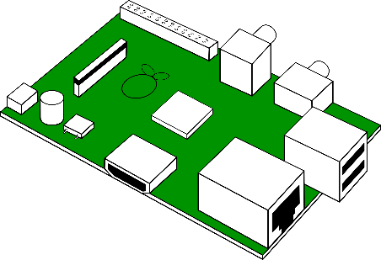
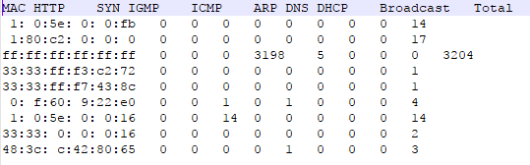
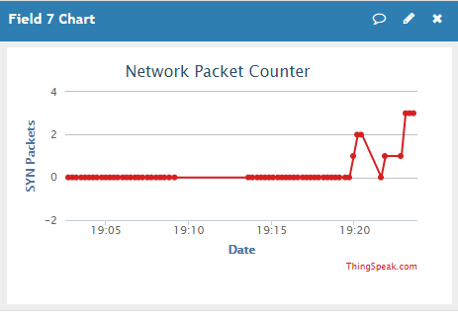
Testing Environment
Internet
Broker
Web dashboard
Packet Generator
Upload status
Monitor status
LAN
Analyze Packets

Slide 5
Prototype Operation
Packet generator to generate captured packet types
RaspberryPi Ethernet switched to Promiscuous mode to capture packets.
Packet Analyzer to analyse packets, upload statistics and log to a text file
Upload statistics of each packet to Thingspeak.com
Monitor the network status using Web Dashboard of Thingspeak.

Slide 6
Future work and Conclusion
Alert if abnormal activities are detected
User friendly interface
GUI
LED/Alarm/Call to alert the administrator
Detect Network Device Activity
Monitor Jitter
Monitor Delay
Monitor Ping requests

Slide 7
Thank you!

